Slide 1
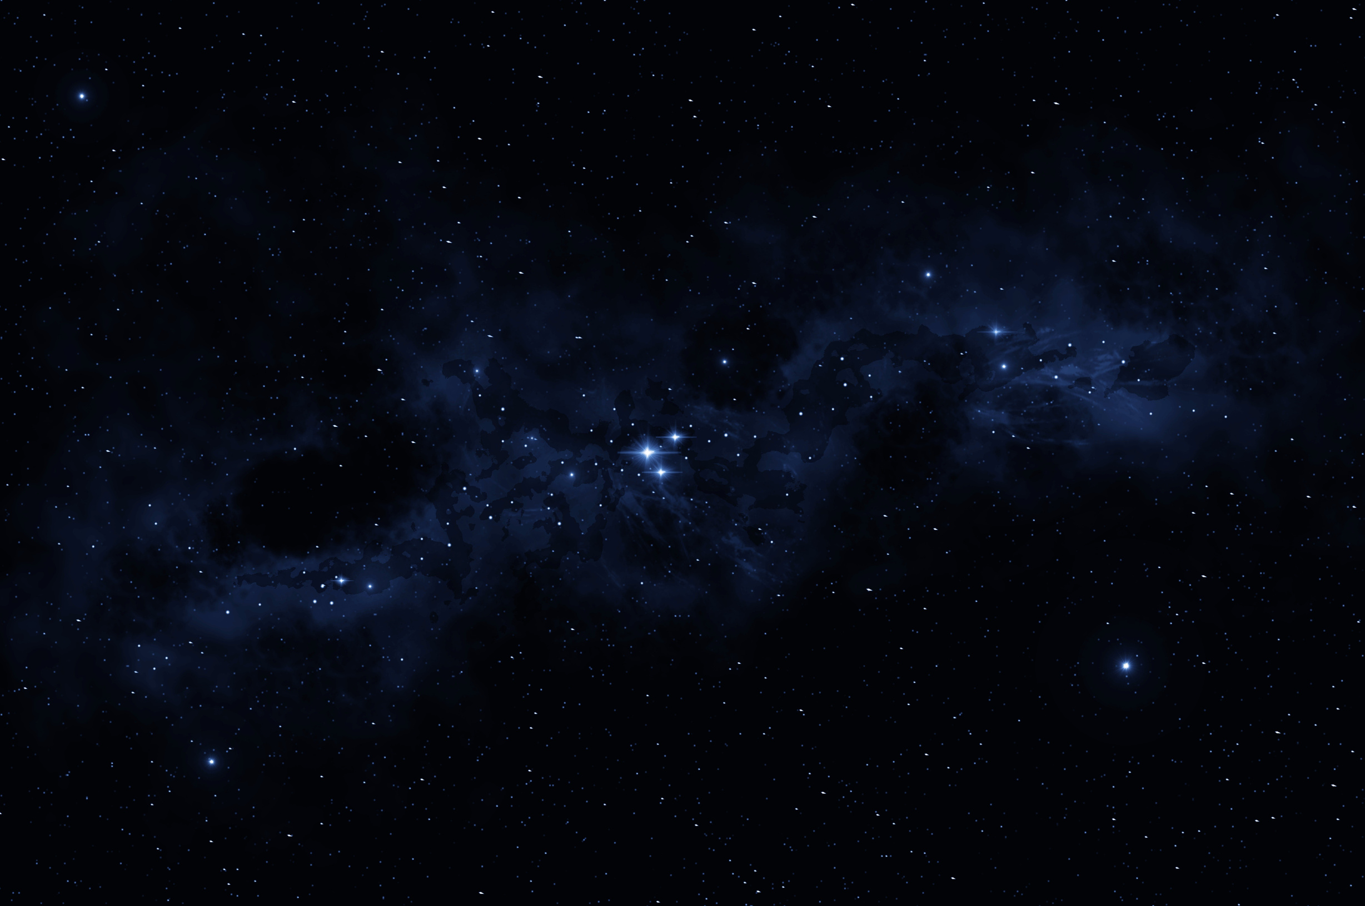

NASA APP CHALLENGE
Challenge
Symphony of the Stars: Harmonizing the James Webb Space Telescope in Music and Images
Text editor :VS Code
Language: HTML,CSS,
JAVASCRIPT

Slide 2

Project summaruy:
Project Summary: Symphony of the Stars: Harmonizing the James Webb Space Telescope in Music and Images
The "Symphony of the Stars" project creatively merges the stunning imagery and groundbreaking discoveries of the James Webb Space Telescope (JWST) with music and interactive web design. By using HTML, CSS, and JavaScript in Visual Studio Code, we developed an engaging online platform that showcases these celestial wonders.
Development Details: We designed a visually appealing collage that presents JWST's images in a unique and artistic way. Additionally, we created a dedicated page that allows users to explore the galaxies from the inner viewpoint of the telescope, offering an immersive experience.
Challenge Addressed: This project addresses the challenge of making complex scientific discoveries accessible and engaging to a wider audience, including young children. By presenting information in a fun and interactive manner, we aim to spark curiosity and interest in space exploration.
Importance: The significance of this project lies in its ability to educate and inspire people of all ages. By simplifying complex concepts and showcasing the beauty of the universe, even a five-year-old can appreciate the incredible discoveries made by the JWST, fostering a love for science and exploration.

Slide 3
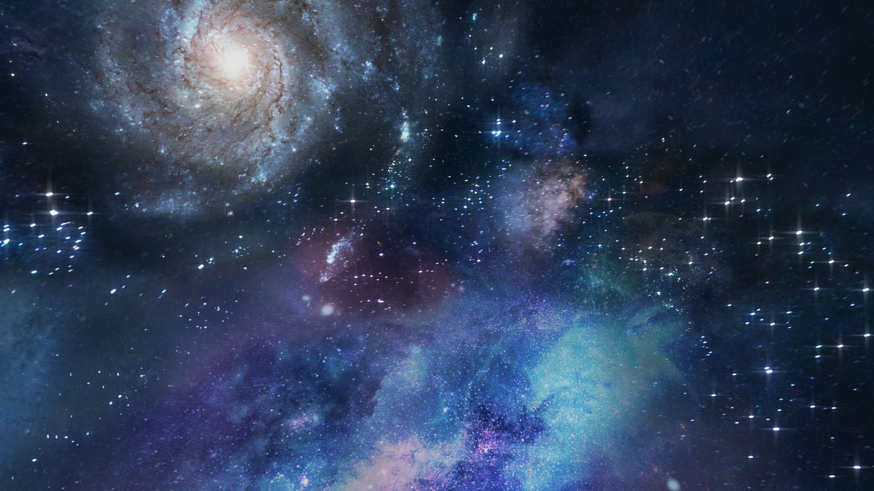
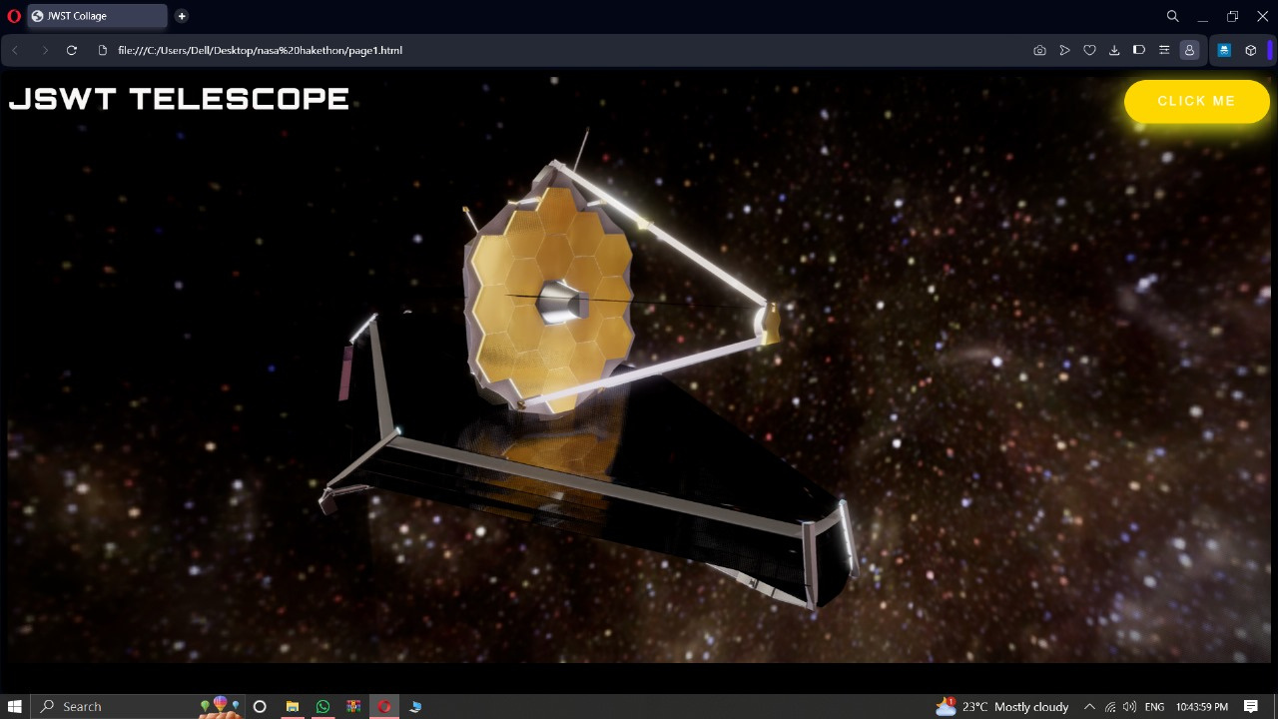


Page 1:
Page 1: Gives user a 3D experience of JWST telescope

Slide 4
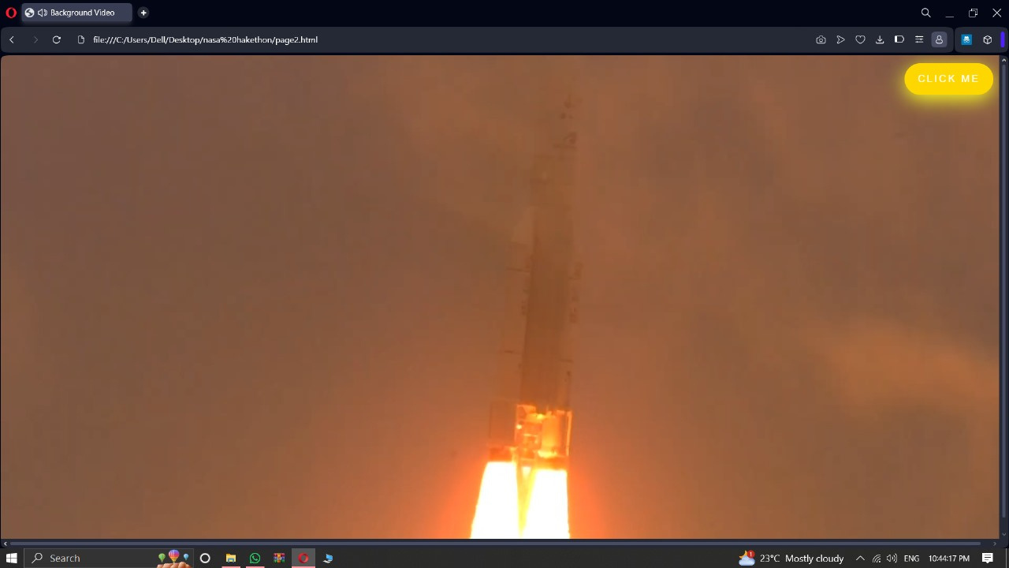


Page 2:
Page 2: Introduction, Making, Launch & Journey of JWST

Slide 5
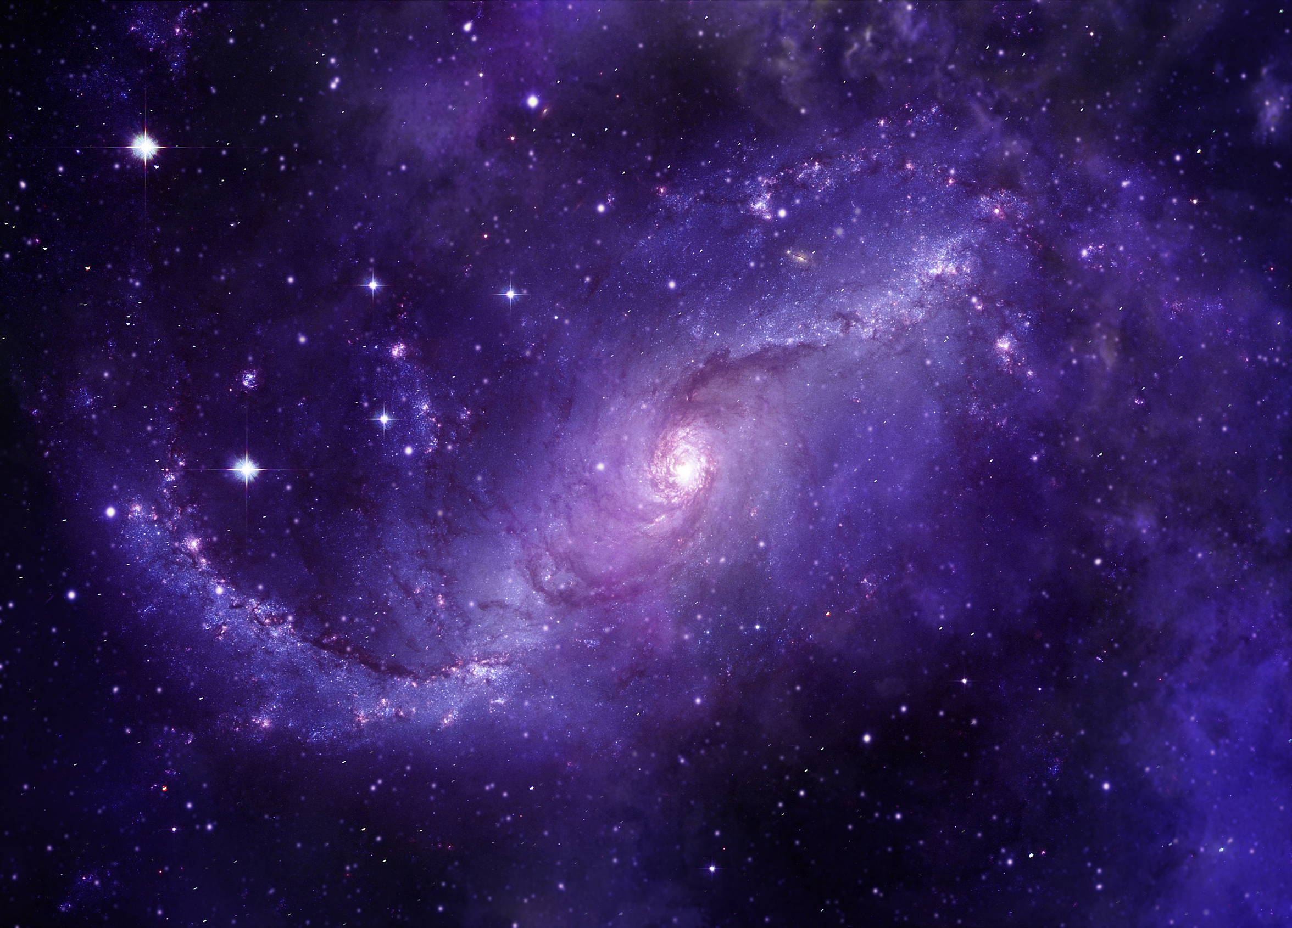
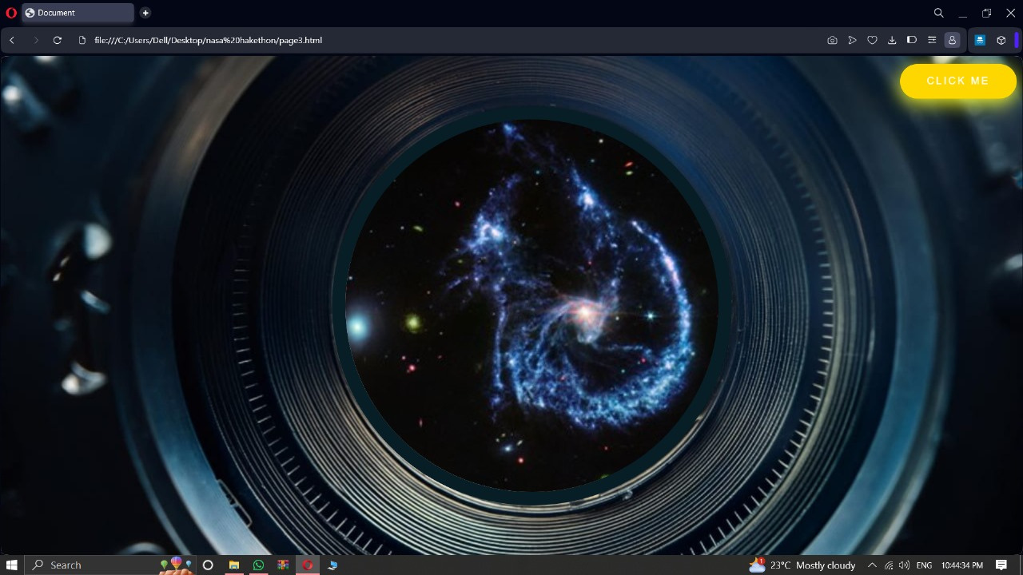

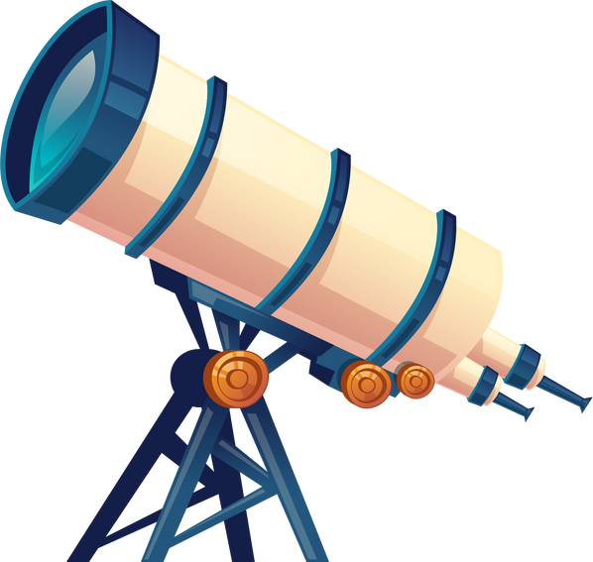
Page 3:
Page 3: Shows the captured images of JWST from telescope view point

Slide 6

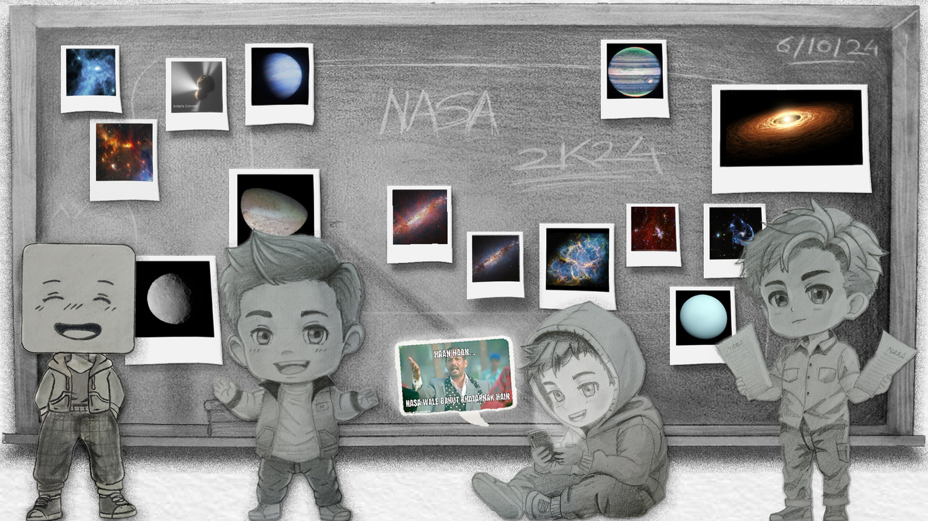
Page 4:
Page 4: Collage of JWST captured images

Slide 7
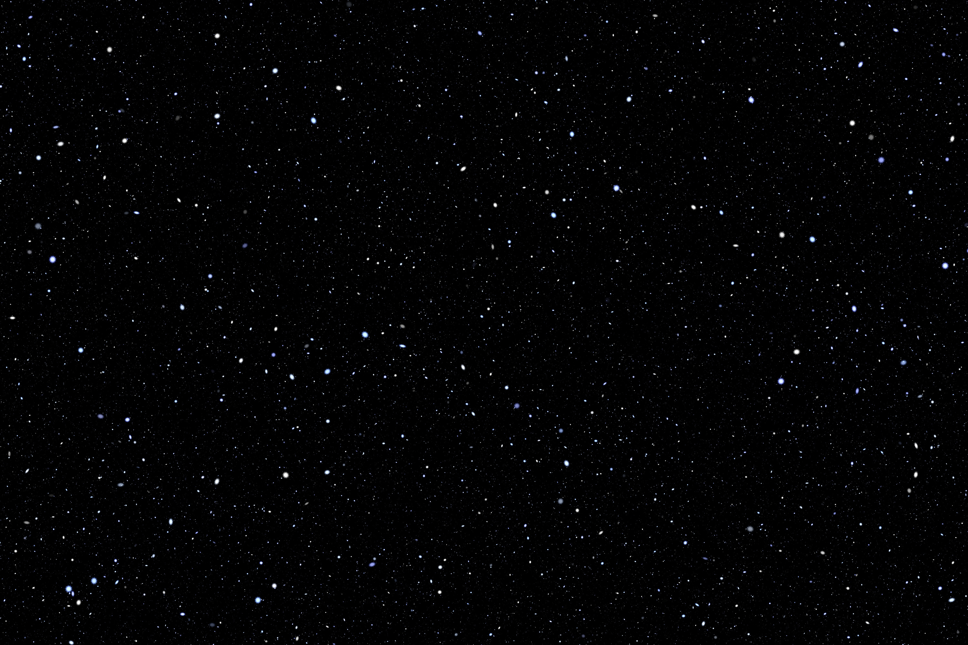
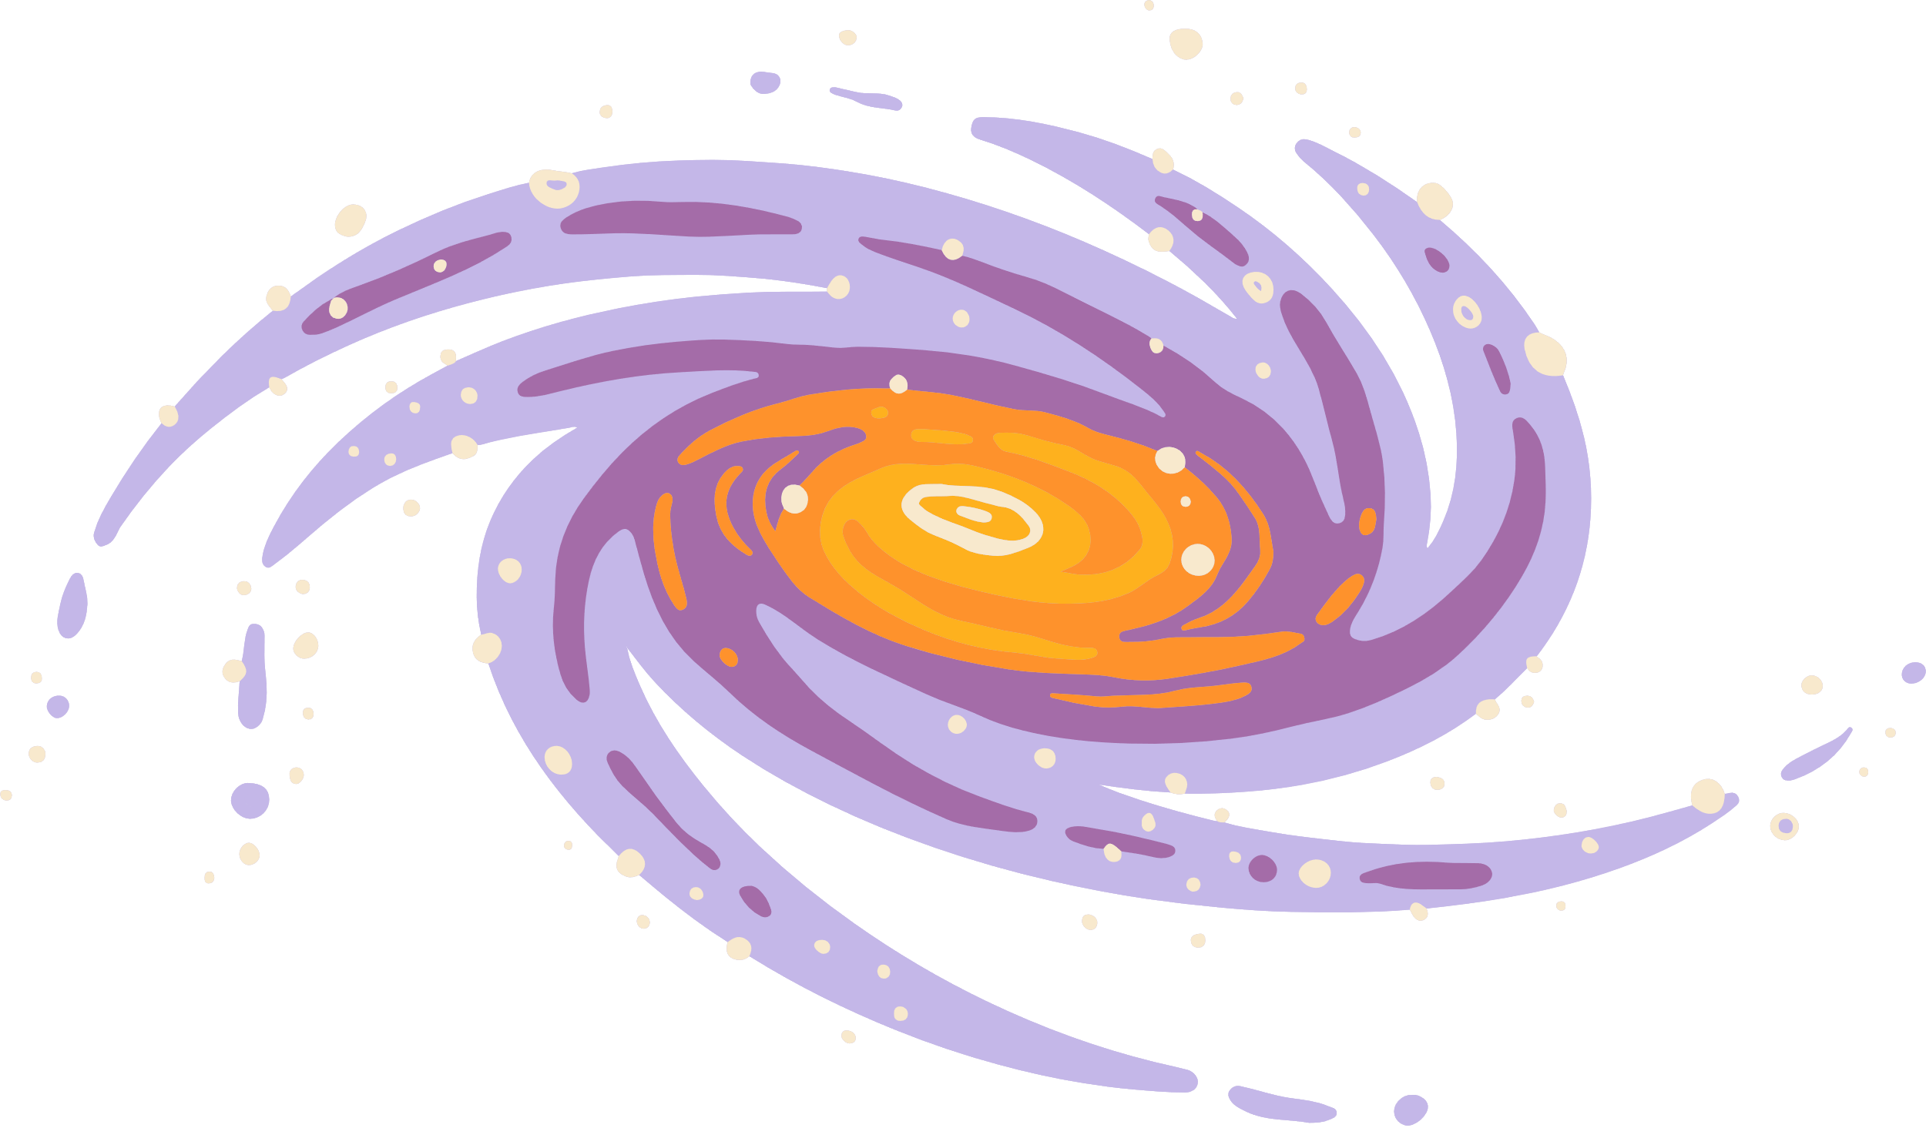

Conclusion:
Engaging Visuals: The collage of JWST images provides a compelling overview of the telescope's groundbreaking discoveries, sparking curiosity and wonder.
Immersive Experience: The simulated telescope viewpoint offers a unique perspective, allowing visitors to feel as if they are looking out into the vast expanse of the universe.
Effective Use of Web Technologies: Your skillful application of HTML, CSS, and JavaScript has resulted in a visually appealing and interactive website.
By combining the power of technology with the beauty of astronomy, your website has become a valuable resource for anyone interested in exploring the mysteries of the cosmos.

